Slide 1
Project 2
Andy G., Caleb R., Cody n.

Slide 2
Learning objectives
Encapsulation
Inheritance
Polymorphism
Data Structure
File I/O
Software Development (AGILE)
Working in groups

Slide 3
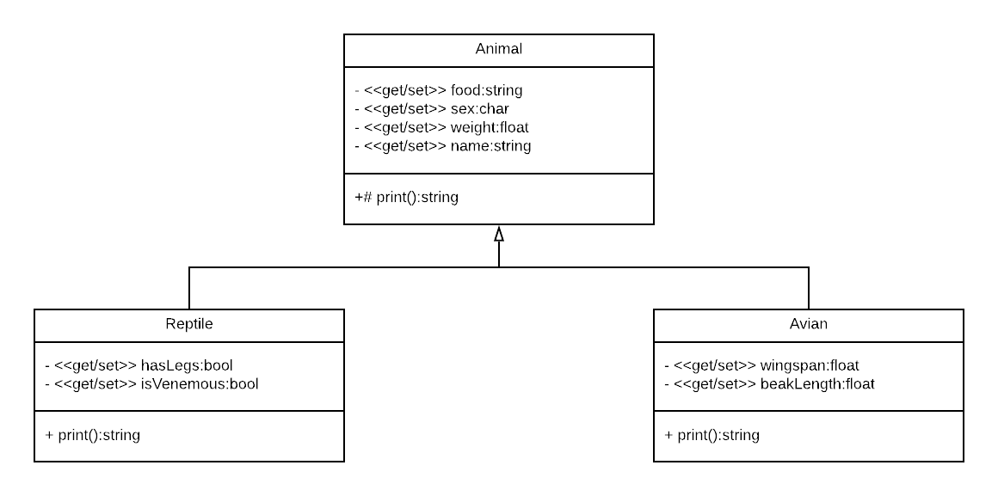
class

Slide 4
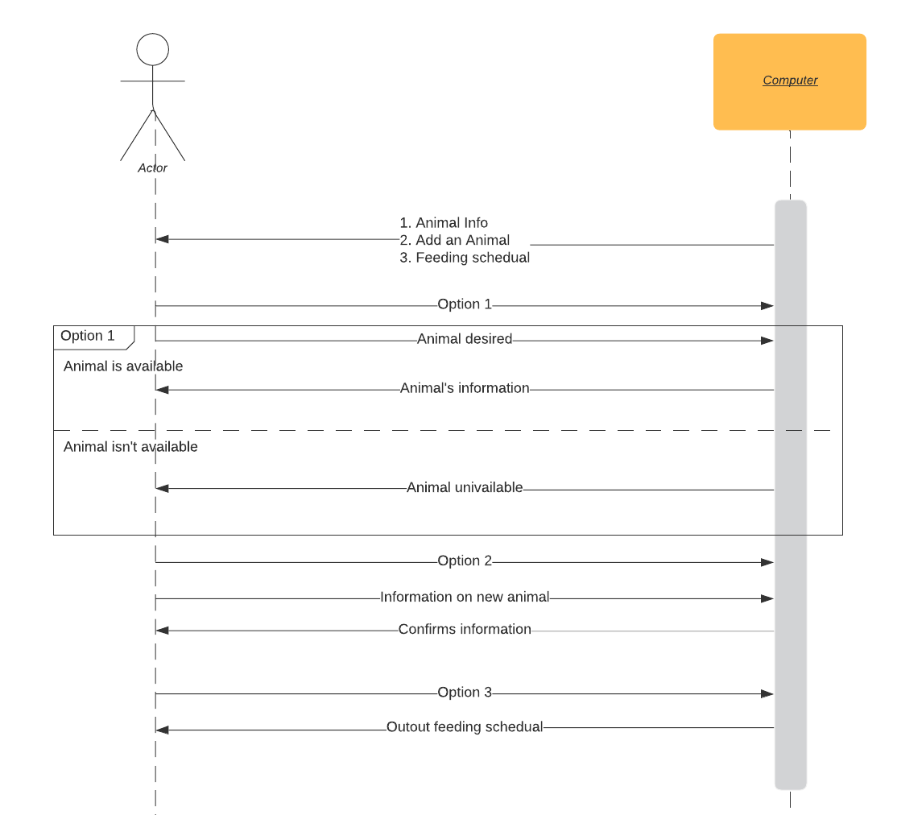
sequence

Slide 5
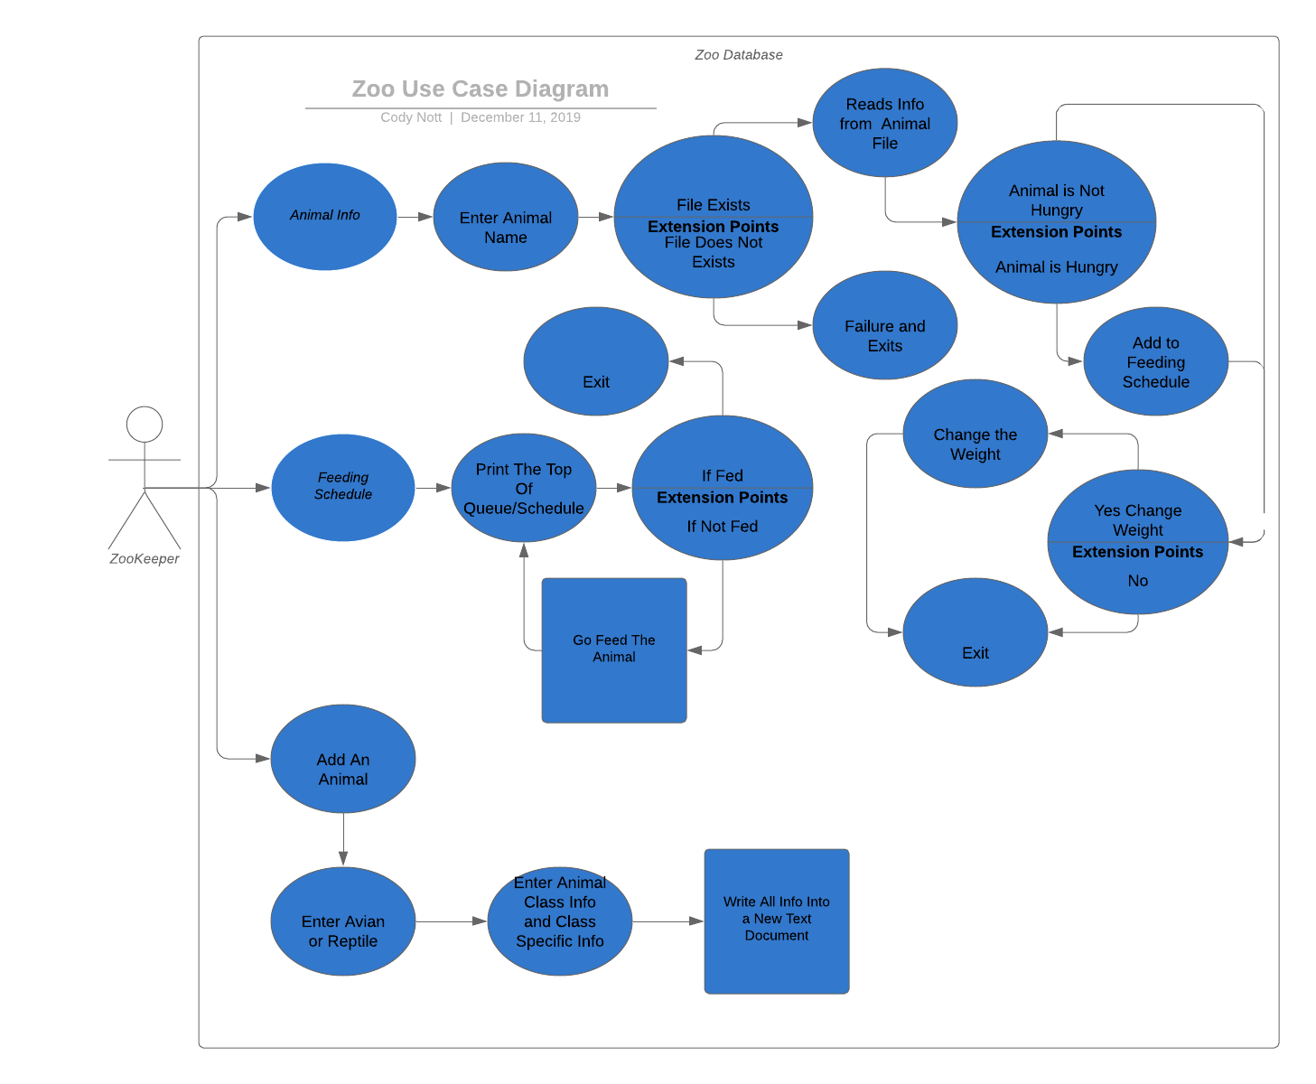
Use case

